Slide 1
Organogram of Smart Technologies (BD) Ltd.
Chairman
Managing Director
Corporate Sales Dept.
Director
Enterprise Solutions
Director
Corporate Tender Dept.
General Manager
Dy. Managing Director
Advisor
IT Distribution
Sales & Marketing
Director
Enterprise Solutions (HPE).
General Manager
Enterprise Solutions (Dell).
General Manager
Enterprise Network Solutions
General Manager
Product & Marketing Department
General Manager
Security & Network Dept.
Dy. General Manager
Project Management Dept
Sales Department
General Manager
Distribution Branch
Operation
Finance & Accounts
CFO & General Manager
Audit
GM
HR & Admin
GM
Store & Billing Dept.
Asst. General Manager
Import & Logistics Department

Slide 2
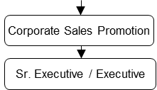
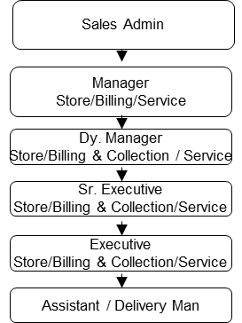
Organogram of Smart Technologies (BD) Ltd.
Corporate Sales Department
Corporate Sales Head Office
Corporate Sales Branch Office
General Manager
Dy. General Manager
Asst. General Manager
Senior Manager
Manager
Dy. Manager
Asst.. Manager
Senior Executive
Executive

Slide 3
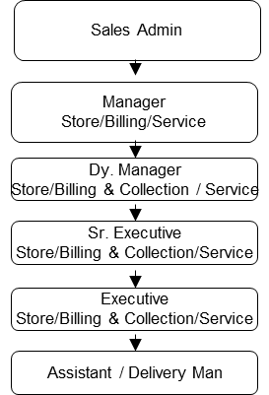
Organogram of Smart Technologies (BD) Ltd.
Corporate Tender Department
General Manager
Dy. General Manager
Asst. General Manager
Senior Manager
Manager
Dy. Manager
Asst.. Manager
Senior Executive
Executive

Slide 4
Organogram of Smart Technologies (BD) Ltd.
Enterprise Solutions Department
DELL & HPE
NETWORK & SECURITY
General Manager
Dy. General Manager
Asst. General Manager
Senior Manager
Manager
Dy. Manager
Asst.. Manager
Senior Executive
Executive
Logistics

Slide 5
Organogram of Smart Technologies (BD) Ltd.
IT DISTRIBUTION
Director
Business Development & Marketing
Branch Operation
Store & Billing
Distribution Business
General Manager
Dy. General Manager
Asst. General Manager
Senior Manager
Manager
Dy. Manager
Asst.. Manager
Senior Executive
Executive
Logistics

Slide 6
Organogram of Smart Technologies (BD) Ltd.
Finance & Accounts and Audit Department
CFO & GENERAL MANAGER
Dy. General Manager
Asst. General Manager
Senior Manager
Manager
Dy. Manager
Asst.. Manager
Senior Executive
Executive

Slide 7
Organogram of Smart Technologies (BD) Ltd.
HR & Admin Department
GENERAL MANAGER
Dy. General Manager
Asst. General Manager
Legal Manager
Senior Manager
Manager
Dy. Manager
Asst.. Manager
Senior Executive
Executive

